Slide 1
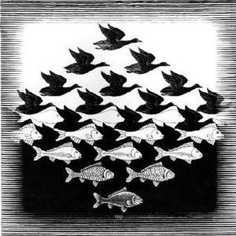
Initial Impression：
Initial Impression:
The first time I saw this painting, although it was black and white, it was really amazing, because clearly what I saw was a bird but it slowly changed into a fish. It was really great! There is a blend of sky and sea. And it has a three-dimensional feel to it.

Slide 2
Description：
Description:
When I see this painting, the first thing that comes to my mind is freedom, because the birds in the sky symbolize freedom in my opinion. I think the birds and the fish also symbolize a kind of food chain, the birds will catch the fish to eat. Or maybe there is a feeling between the bird and the fish. I can't think of the specific content of the story, nor can I guess the artist's mind. But I think this work must have a deep meaning.

Slide 3
Analysis：
Analysis:
The author makes good use of color, especially light and dark, and uses black and white to contrast and distinguish the two animals. It's a little bit like the Zentangle that we've seen before, which gives you a jigsaw puzzle feel.

Slide 4
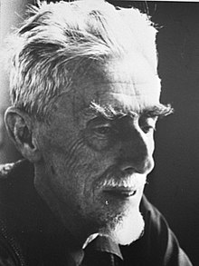
Cultural Context：
The painting was painted by M. C. Escher (June 17, 1898 -- March 27, 1972), a Dutch painting artist who produced mathematically inspired woodcut prints, lithography, and mezzotints.
His work features mathematical objects and operations, including impossible objects, infinite exploration, reflection, symmetry, perspective, truncation and star-shaped polyhedra, hyperbolic geometry, and mosaics.
Mr Escher's work is inevitably mathematical.

Slide 5
Informed Point of View：
I think Escher's work is a combination of science and art, which is why he doesn't have much of a reputation in the art world.
This reminds me of a very interesting video on TikTok by a creative woman who loves to create a lot of "magic potion bottles."
Let's see what she says about the connection between art and chemistry.

Slide 6
Thanks for watching！

